Slide 1

Working with Waits and Synchronization
Module 4

Slide 2
Understanding Waits and Synchronization
Usual problem without waits and synchronization
Test fails due to timing discrepancies (milliseconds) between web elements and test execution
Web element not found
Web element not ready for interaction
Stale element
Waits and synchronization handles the following
Web pages loading asynchronously
Web elements not immediately available (slow loading elements)
Web pages having AJAX calls, and JavaScript-heavy sites (re-loading elements)
Waits and synchronization ensures stability and reliability of tests in a dynamic web applications.

Slide 3
Types of Waits
Type | Description | Use Case
Implicit Wait | Waits for elements to appear on the page Default wait time for all elements | Simple use case where you want the system to wait for elements to load without specifying time for each one
Explicit Wait | Waits for specific conditions to be true before proceeding Defined for individual elements | Specific scenarios where you want to wait for conditions to be met before interacting with elements
Fluent Wait | A type of explicit wait with more control over polling frequency and timeout | Complex waiting requirements, such as handling intermittent failures or varying page loads

Slide 4
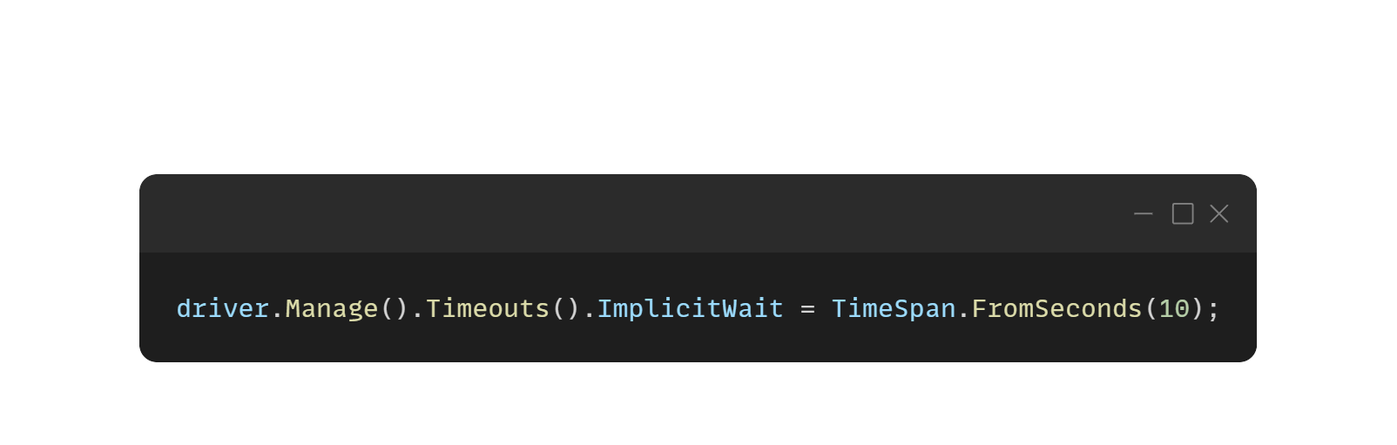
Understanding Implicit Wait
Wait for a specific amount of time before throwing an exception if the element is not found
Pros | Cons
Easy to implement globally | Slows down the execution if misused
Automatically applies to all elements | Global effect can cause delays

Slide 5
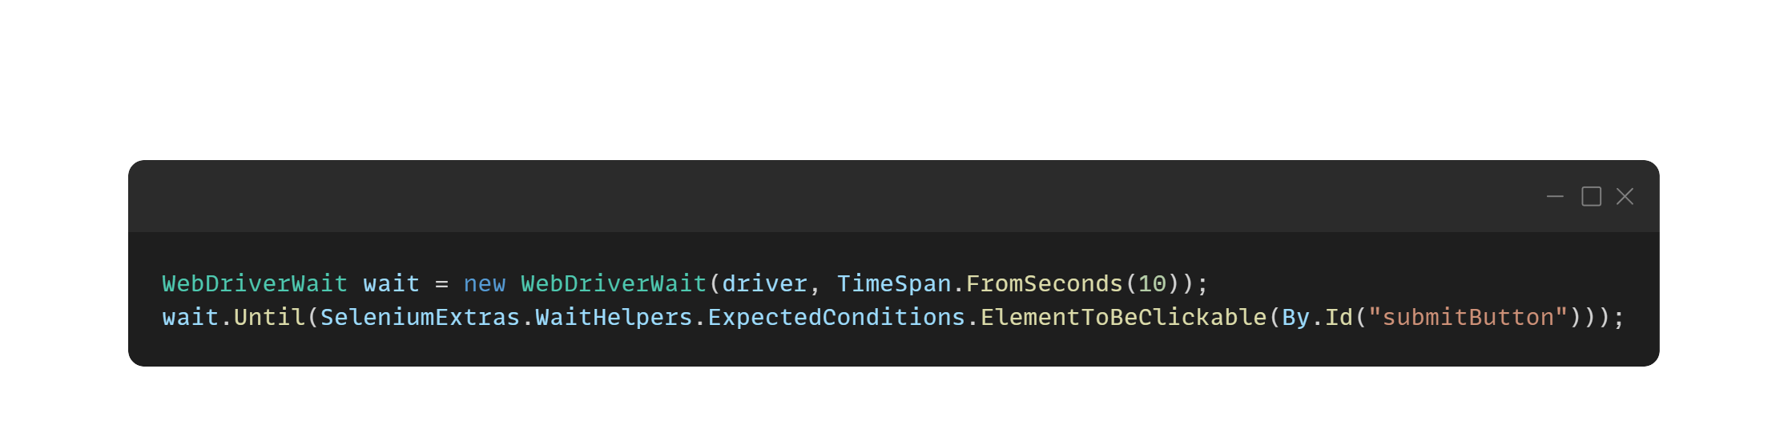
Understanding Explicit Wait
Waits for a certain condition to occur before proceeding
Common conditions: ElementToBeClickable, ElementIsVisible, ElementExists
Pros | Cons
Can be customized for specific conditions | Requires more code
Avoids unnecessary waits | May require debugging if conditions aren't met

Slide 6
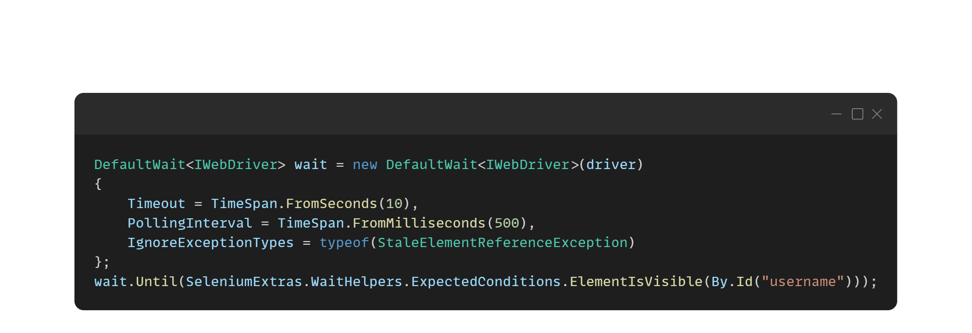
Understanding Fluent Wait
Allows you to define polling frequency and maximum wait time
Pros | Cons
Handles intermittent issues well | Most complex
Can ignore specific exceptions | May be overkill for simple cases

Slide 7
Hands-on Activity
Create a new console project named ‘Module4’
Write a selenium script for the following Test Steps
Use combination of wait types
Use Implicit wait of 500 milliseconds
Use Explicit wait - ElementToBeClickable of 15 seconds for buttons and menus
Use Explicit wait - ElementIsVisible of 15 seconds for input fields
Push your code to your GitHub Repo using GitHub Desktop Application

Slide 8
Test Steps
Open Chrome Browser
Navigate to URL https://www.saucedemo.com/
Input UserName {standard_user}
Input Password {secret_sauce}
Click Login Button
Click Burger Menu
Click Logout
Close Chrome Browser

